Slide 1
Properties of People (Part II)
Dishwashing liquid bubbles as feedback
(don’t put in dishwasher)
Add administrivia
Also note midterm exam earlier time
Affordances
Speech UIs (hard)
Gdocs Todo tag
Programming Usable Interfaces (PUI)
Jason Hong
jasonh@cs.cmu.edu

Slide 2
Recap of Last Time
Good and Bad Use of Color
Understand basics of eye structure, rods / cones
Color blindness (rough % and most common type)
Five design tips
Fitts’ Law
Intuition behind it (bigger + closer targets faster)
Implications for usability
Gulf of Evaluation and Execution
What they are, why they might happen

Slide 3

HDR 10-bit color
Notes:
https://fstoppers.com/education/can-you-see-difference-between-10-bit-and-8-bit-images-and-video-footage-166977

Slide 4
What are Some Ways of Addressing Gulf of Evaluation and Execution?
Mental Models
Affordances
Feedback
Mappings
Visual Grouping / Separation
Metaphor
User
System

Slide 5
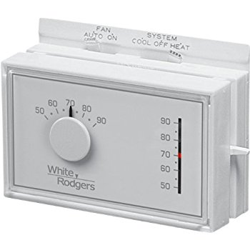
Pop Quiz (not graded)
Scenario: it’s really cold in a room (50 F), and you want the room to get to 70 F.
Does raising the thermostat higher (say to 90F) make it get warmer faster?
Notes:
Thermostat mental model 1: like a faucet, higher makes it get warmer faster
Thermostat mental model 2: like an on/off switch (typically the correct mental model)

Slide 6
Another Example Refrigerator
Freezer
Fresh food
Problem: Freezer too cold, but fresh food just right

Slide 7
Refrigerator Controls
Normal Settings C and 5
Colder Fresh Food C and 6-7
Coldest Fresh Food B and 8-9
Colder Freezer D and 7-8
Warmer Fresh Food C and 4-1
OFF (both) 0
A B C D E
7 6 5 4 3
What would you do to make freezer less cold?
Notes:
Inside the refrigerator, you see two dials (ABCDE and 76543) and some instructions

Slide 8
A Common Mental Model Independent Controls
A B C D E
Cooling
Unit
7 6 5 4 3
Cooling
Unit
Notes:
This is a common way people would think the fridge example shown previously works

Slide 9
A More Accurate Mental Model
What are design options for fixing the problem?
Make controls map to user’s model
Make controls map to actual system
A B C D E
Cooling
Unit
7 6 5 4 3
Notes:
But it actually works like this
So if you think it works like previous model, you have almost no chance of making it work

Slide 10
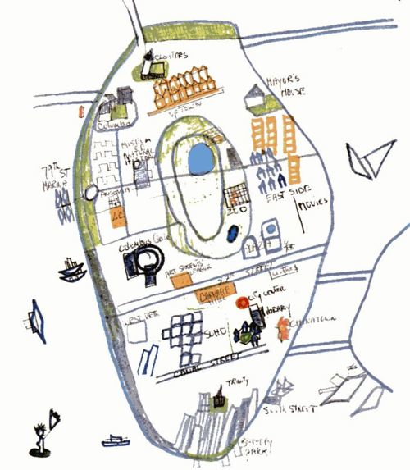
Mental Models
Mental models describe how a person thinks something works
Incorrect mental models can make things very hard to understand and use
People inevitably build models of how things work
Ex. Children & computers
Ex. Maps of New York

Slide 11
Every System has Three Different Mental Models
Design Model
(How you intend the system to work)
User Model
(How users think the system works)
System Image
(Your implementation)
User Interactions
System feedback
Notes:
Every system has at least three models (from Don Norman’s book).
People only interact with the system image, and so may not understand your intended Design Model.
Note that what you design (the Design Model) does not always match the User Model. Large mismatches can cause problems.

Slide 12
Notes on Mental Models
People inevitably have some mental model
From past experiences, what they hear from others, documentation, and interactions with system image
All mental models are approximations
But some more useful and more accurate than others
There isn’t necessarily one correct mental model
Experts can disagree, e.g. Native Americans and environmentalists categorized fish differently
Again, two general strategies:
Foster better mental model, or design to match users

Slide 13
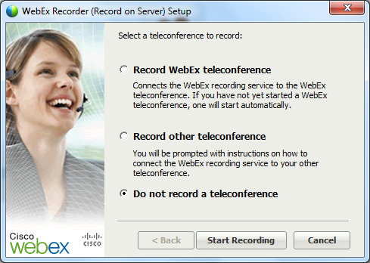
Using Mental Models
Predictability important criteria
What will happen if you hit the “Start Recording” button?
Notes:
Example is confusing b/c it has option “Do not record a teleconference” but button is “Start Recording”
It can sometimes be hard to make use of mental models directly.
The most immediate thing you can do with mental models is to consider predictability.
For example, here is a screenshot from WebEx. We’ve selected “Do not record a teleconference”, but to continue, we have to hit the “Start Recording” button. So we have a conflict in the mental model here.

Slide 14
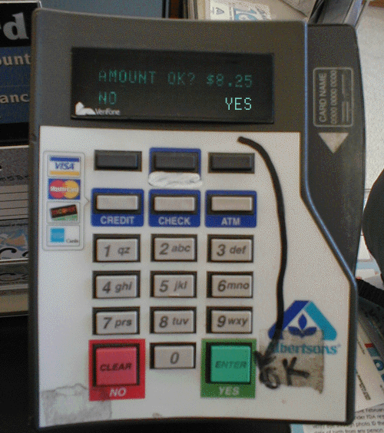
Using Mental Models
Another unclear model. A lot of people probably hit the button under “Yes”.
That clearly doesn’t work, based on the drawn arrow.
(We’ll see this example again later today)
Notes:
Note how broken this interface is, someone actually drew an arrow on it.
This is also a mapping problem and a visual grouping problem

Slide 15
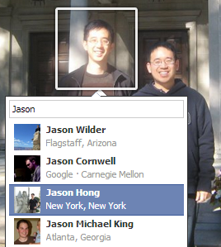

Mental Models and Security
Visibility in Facebook
Suppose you have a private Facebook album, and then tag someone. Can that person see it or not?
Smartphone app stores
All apps are vetted by Google, so they are all safe to download. Correct?
Mental models can influence behaviors too
Notes:
Not only can they see it, apparently that person’s friends can see the tagged image too (at least it was last time I checked)
http://rickwash.com/papers/nspw06r-wash.pdf describes folk models for security

Slide 16
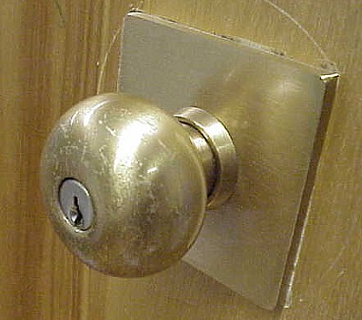
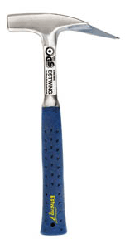
Affordances
Well-designed objects have affordances
Clues to their operation that are readily apparent
Often visual, but not always (e.g., speech)
Allows and promotes certain actions
Door knobs afford turning
Handle of hammer affords grasping in particular way
Norman: signifiers vs affordances
Affordances are relationship bet. person and object
Signifiers are the (visual) cues
Most of HCI community still using term affordance

Slide 17
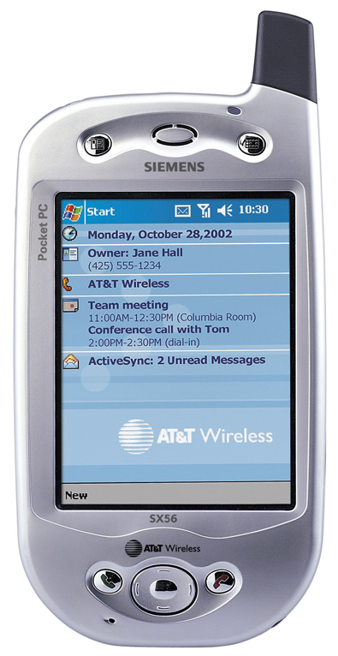
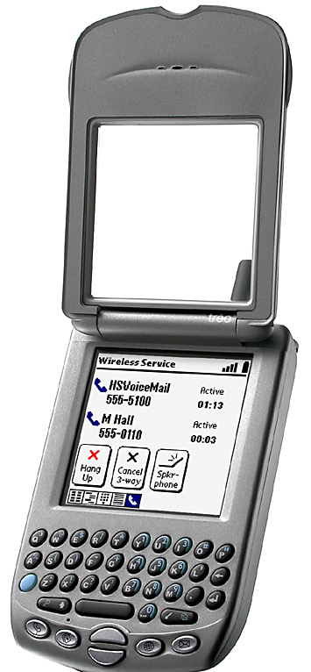
Affordances as Perceptual Clues
Siemens Pocket PC Phone
Pen input, no keypad
Handspring Treo
Pen input/keypad input
Notes:
In DOET, affordances are visual. But affordances are more than that. Affordances are anything that can be perceived

Slide 18
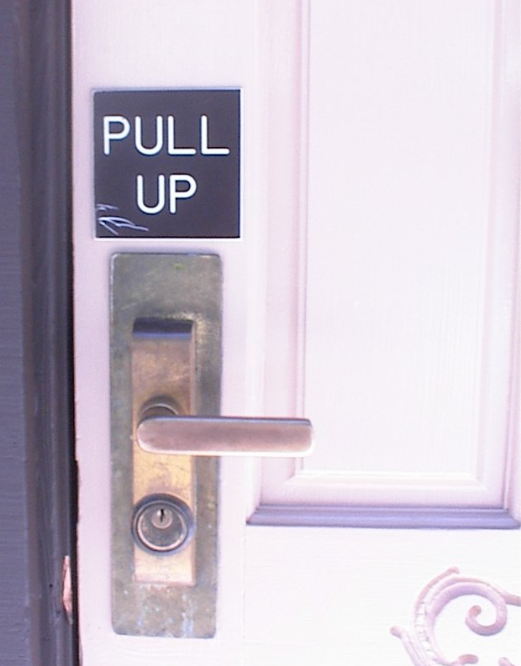
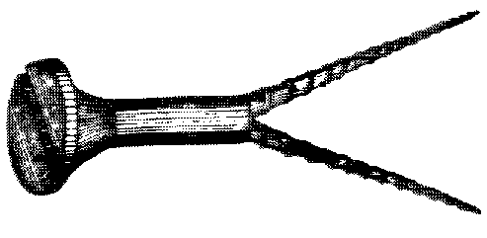
Affordances as Perceptual Clues
Poorly-designed objects
No clues or misleading clues
French artist Jacques Carelman
Crazy design for a screw punch!
Notes:
In DOET, affordances are visual. But affordances are more than that. Affordances can be

Slide 19
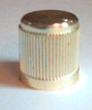
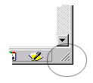
“Virtual Affordances”
Visual appearance can suggest function
Example: Knurling
Small ridges typically found on knobs
Increases friction → Affords grip
Leveraging real-world knowledge
Don’t have to know about knurling for this to afford “grip” with the mouse

Slide 20
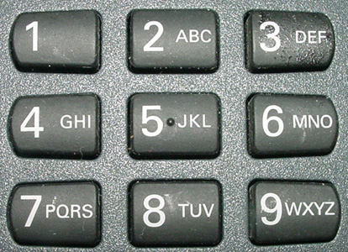
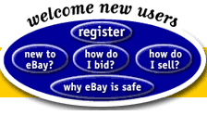
“Virtual Affordances”

Slide 21
Design Implications
Make sure interactive objects have affordances that suggest what you can do
Note that standard GUI widgets have “standard” affordances through learned convention
So you don’t have to do anything special here
ComboBox

Slide 22
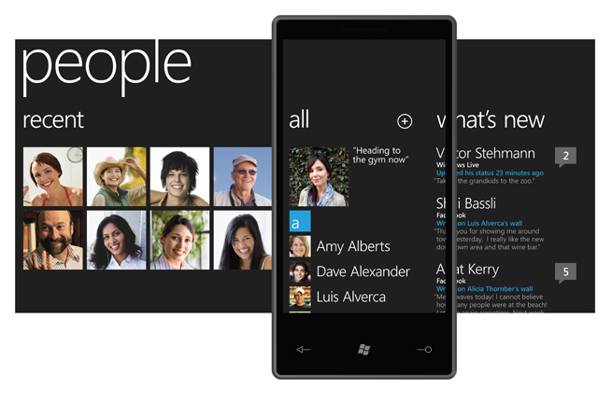
Good Example: Windows Phone
Note that not all affordances have to mimic real world, just need to offer a hint as to what interactions are possible
What’s interesting about this design?
Notes:
Very nice design by Windows Phone UI team
Look at right side, it has a small part of the next screen, suggesting that you can slide over

Slide 23
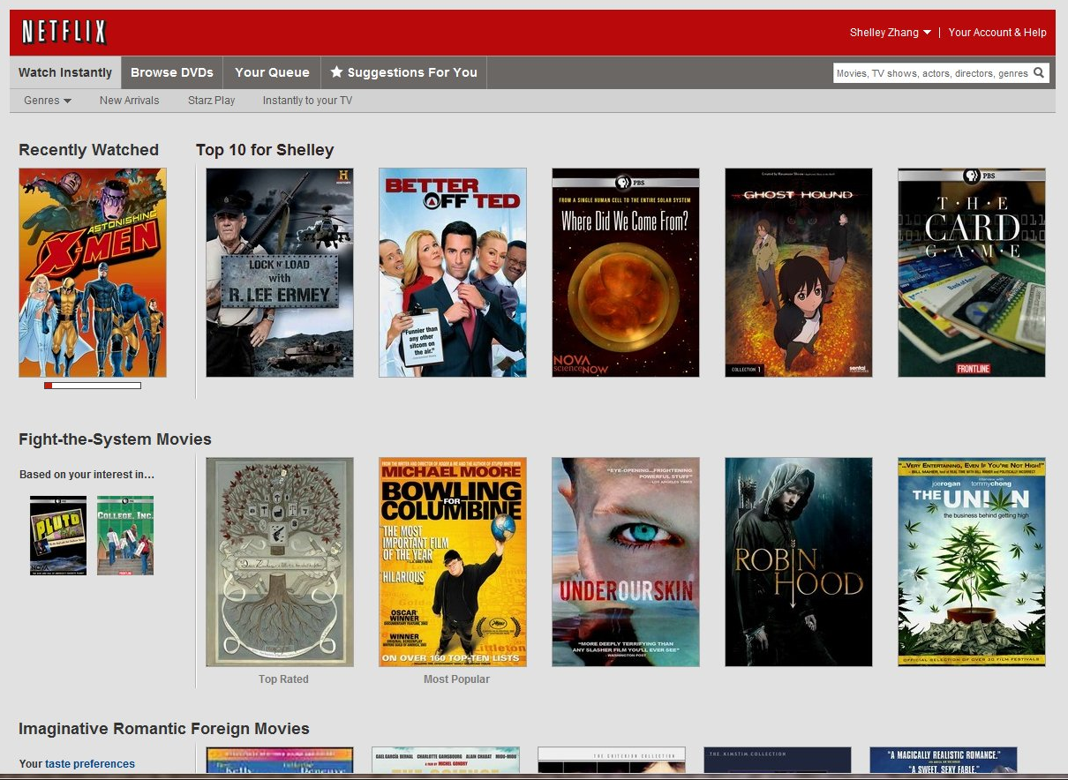
Bad Example Top 10, but only see 5, how to view rest?
Notes:
Previous example we saw
No obvious way to scroll. Turns out you have to mouse over, and then it will show the arrows.
But you don’t click, you just mouse over and then it will slide.

Slide 24
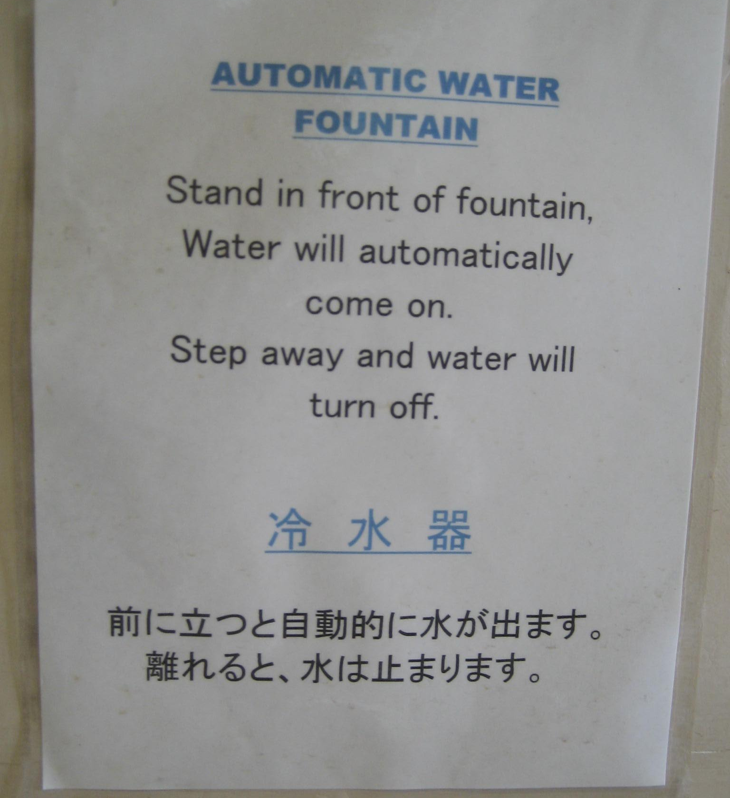
Bad (But Increasingly Common) Example
Sensor-based systems have this problem
Unclear how they work, if broken or not
This is a growing and unsolved design problem (ie sensors)

Slide 25
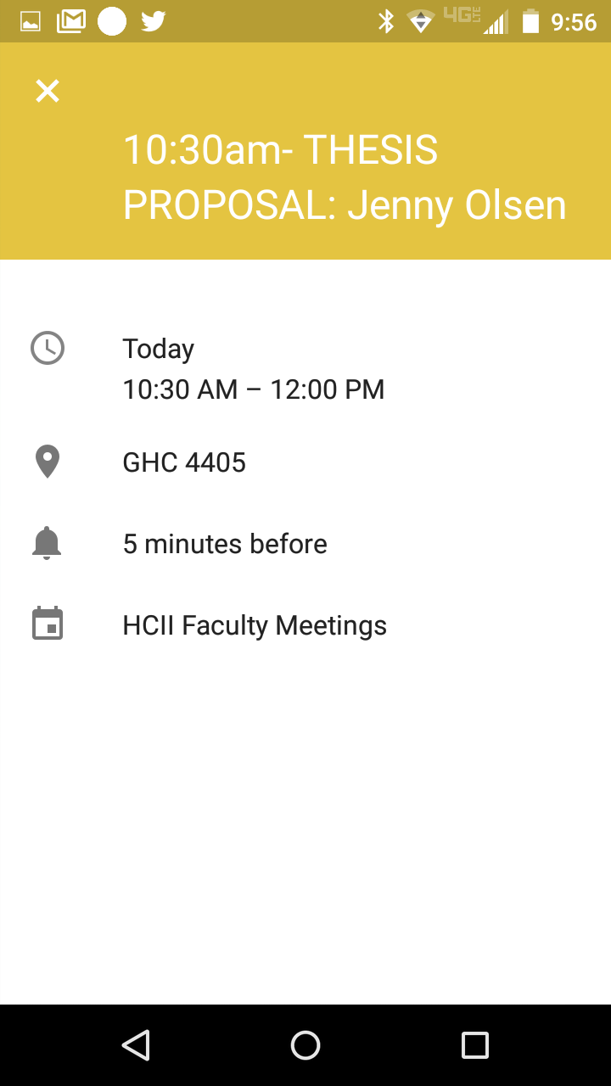
Mixed Example Flat Design / Material Design
Many web sites and apps going to a flat design
Sometimes hard to know what is interactive
Q: What is “clickable” here?
Notes:
What’s clickable here?
The X is clickable
Turns out that the GPS location symbol is clickable too
This is one of the problems with Material Design, tries to be ultra minimalist
One solution to keep minimalism is to add a (View Map) label

Slide 26
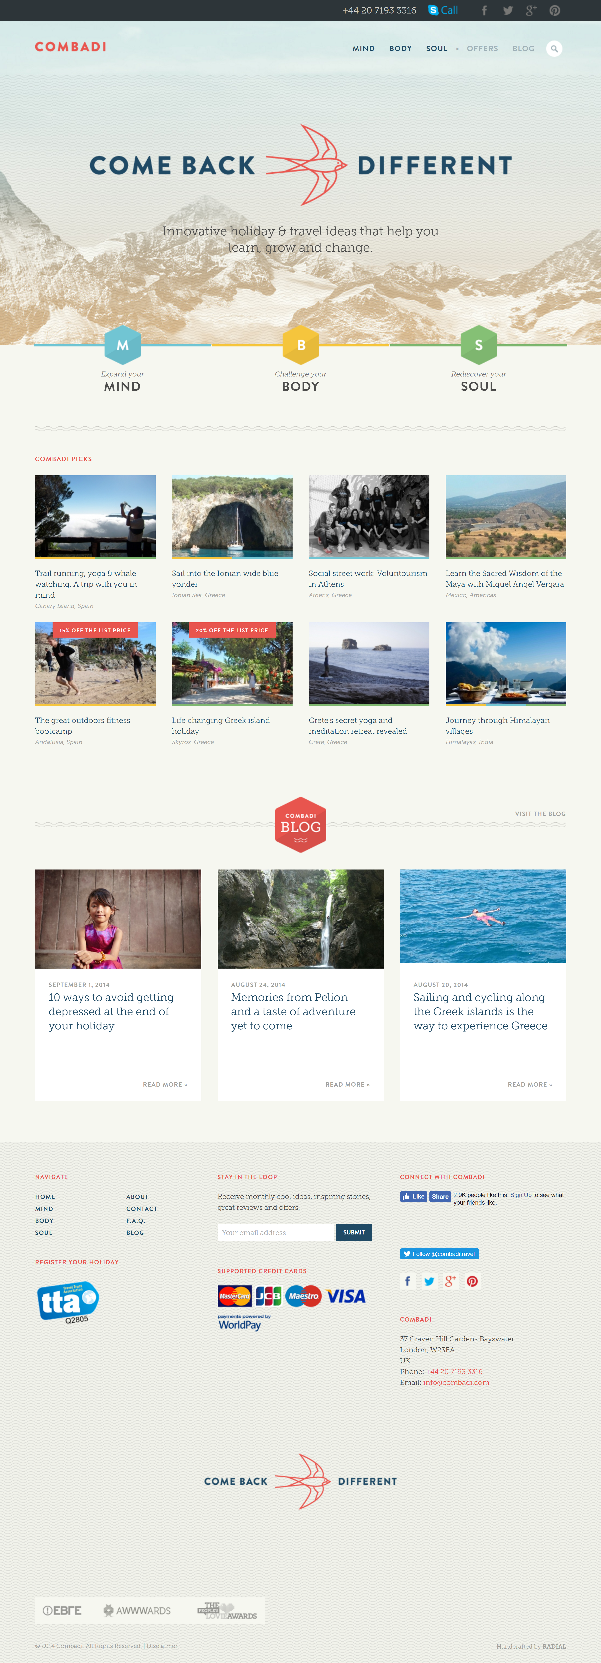
Notes:
What’s clickable here?
http://combadi.com/
Almost everything is clickable except the main “Come Back” and text below
Also needs more contrast for text in center, or a thicker font

Slide 27
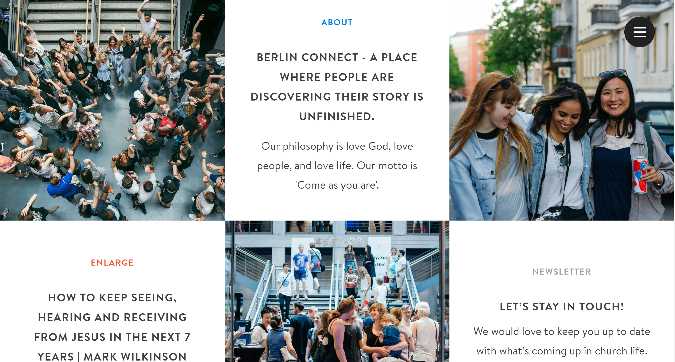

Notes:
http://myberlinconnect.de/
Surprisingly, only a few things clickable here (not About or Enlarge or Newsletter)
Menu icon, Listen, and Subscribe. Rest isn’t.

Slide 28
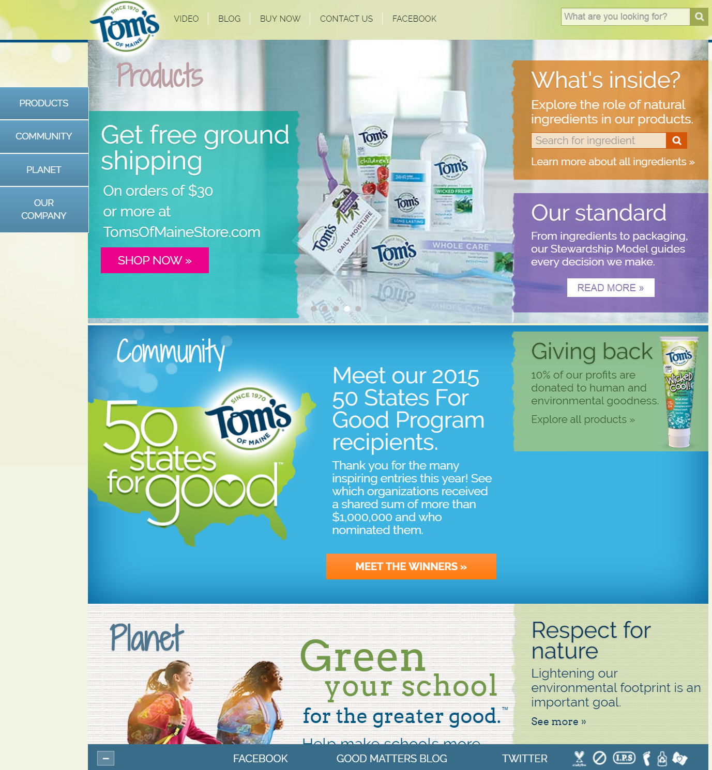
Notes:
Example from https://www.nngroup.com/articles/clickable-elements/
Things with Chevrons are clickable, though rest isn’t. This is a good case of where Fitts’ Law might be really useful, by having larger clickable areas. Also, note that the links don’t necessarily draw a person’s eye to them, so it’s hard to grok quickly what’s clickable and what’s not.

Slide 29
How to Address Gulf of Evaluation and Execution?
Mental Models
Affordances
Feedback
Mappings
Visual Grouping / Separation
Metaphor

Slide 30



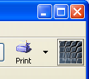

Feedback
Response by system to actions of user
Important for cause and effect
Important for forming mental models
Making “system state” visible
Immediate: Button goes down
Intermediate: Thin black box appears
Delayed: “Thank you for shopping” + email
Sometimes some interactivity just to let you know system is still alive

Slide 31

How Fast are Things Perceived?
Below 20ms (1/50 sec) discrete flashes start to merge into continuous perception
CRTs and LCDs refresh ~60 times per second (60 Hz)
Below 50 Hz many see flicker
Differences in peripheral vision
Peripheral vision highly motion sensitive
What kinds of photoreceptors at edge?
Good for seeing saber tooth tigers
Bad for banner ads
Notes:
Rods at edge of eyes

Slide 32
How Fast are Things Perceived?
Fact #1: < ~20ms (1/50 sec) for continuous
Fact #2: Displays update at 50-75hz
So don’t need to be faster for user response
Because people can’t distinguish
Get ~60 million instructions for 20ms (desktop ~3Ghz)
Get ~36 million instructions (A9 chip is 1.8GHz)
Doesn’t take into account GPUs and multicore
Note: first GUIs had ~20K
Not enough? Apply Moore’s law…
Notes:
Basically, response time will typically be pretty good w/o you having to do anything special
We all have a portable supercomputer in our pockets and purses

Slide 33
How Fast are Things Perceived?
But don’t have to be this strict, for GUIs ~100ms seems like “instant response”
Hard to tell response times below this apart
Upper range of eye saccades
~100ms typical human “cycle time” in Model Human Processor
So except for animation, most GUI responses don’t need to be faster than this
Experiments suggest a little slower still ok for some
Window dragging ~200ms acceptable
Notes:
Note that 100ms is order of magnitude
See Daniel Wigdor’s work for more evaluation on this. Certain kinds of things need to be faster, e.g. smooth animation

Slide 34
How Fast are Things Perceived?
< 1-2 seconds typically “good response time”
Similar times in conversational turn taking protocols
Longer delays ~5 sec have to say something to keep conversation alive

Slide 35
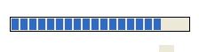
How Fast are Things Perceived?
> 10-15 sec typically bad response time
Short term memory decay effects
Need progress meters here for feedback
Web has trained us for slow response times
Though lots of times I forgot what I wanted to do by the time a page loaded

Slide 36
Perceptual Causality
How soon must red ball move after cue ball collides with it?
Notes:
About 100 msec is upper bound, though faster is better for smooth animation

Slide 37
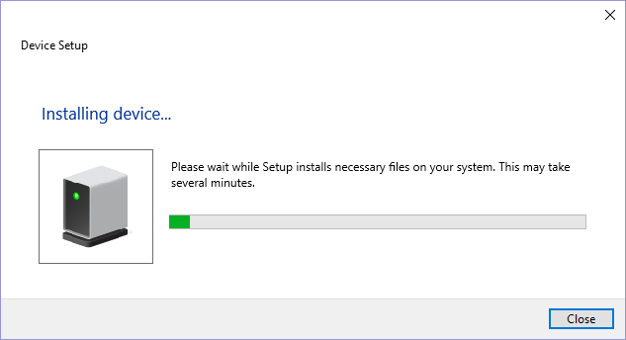
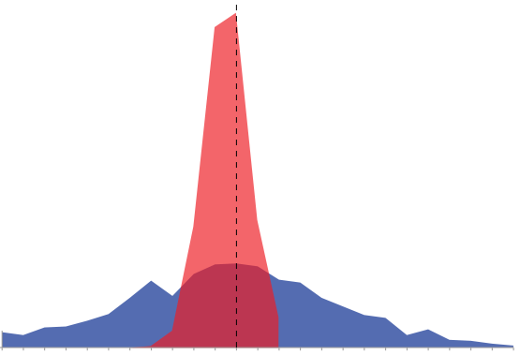
A Little About Response Times
Good vs bad response time depends on expectations
If you can’t meet goals, manipulate user expectations
Ex. “This will take 5 minutes to install”
Ex. Minimum hardware requirements
Consistency and predictability of response more important
You want low standard deviation

Slide 38
About Response Times
Caveat #1 – Programmer intuitions often wrong
Not always clear what is making app slow
“Premature optimization is the root of all evil (or at least most of it) in programming.” – Donald Knuth
Caveat #2 – Perceived response times important too
What tricks do elevators use?
What trick does iOS use when switching between apps?
Apple Newton trash
Amazon book purchase
Notes:
Elevators use: mirrors, notification of which elevator to go to, what floor elevator is on
iOS shows last image of app, gives app a second or two to load
Apple Newton had a cute animation when trashing things, to distract users
In early studies (Jared Spool et al), Amazon’s perceived time to complete a task was better than actual time, made it feel fast vs competitors

Slide 39
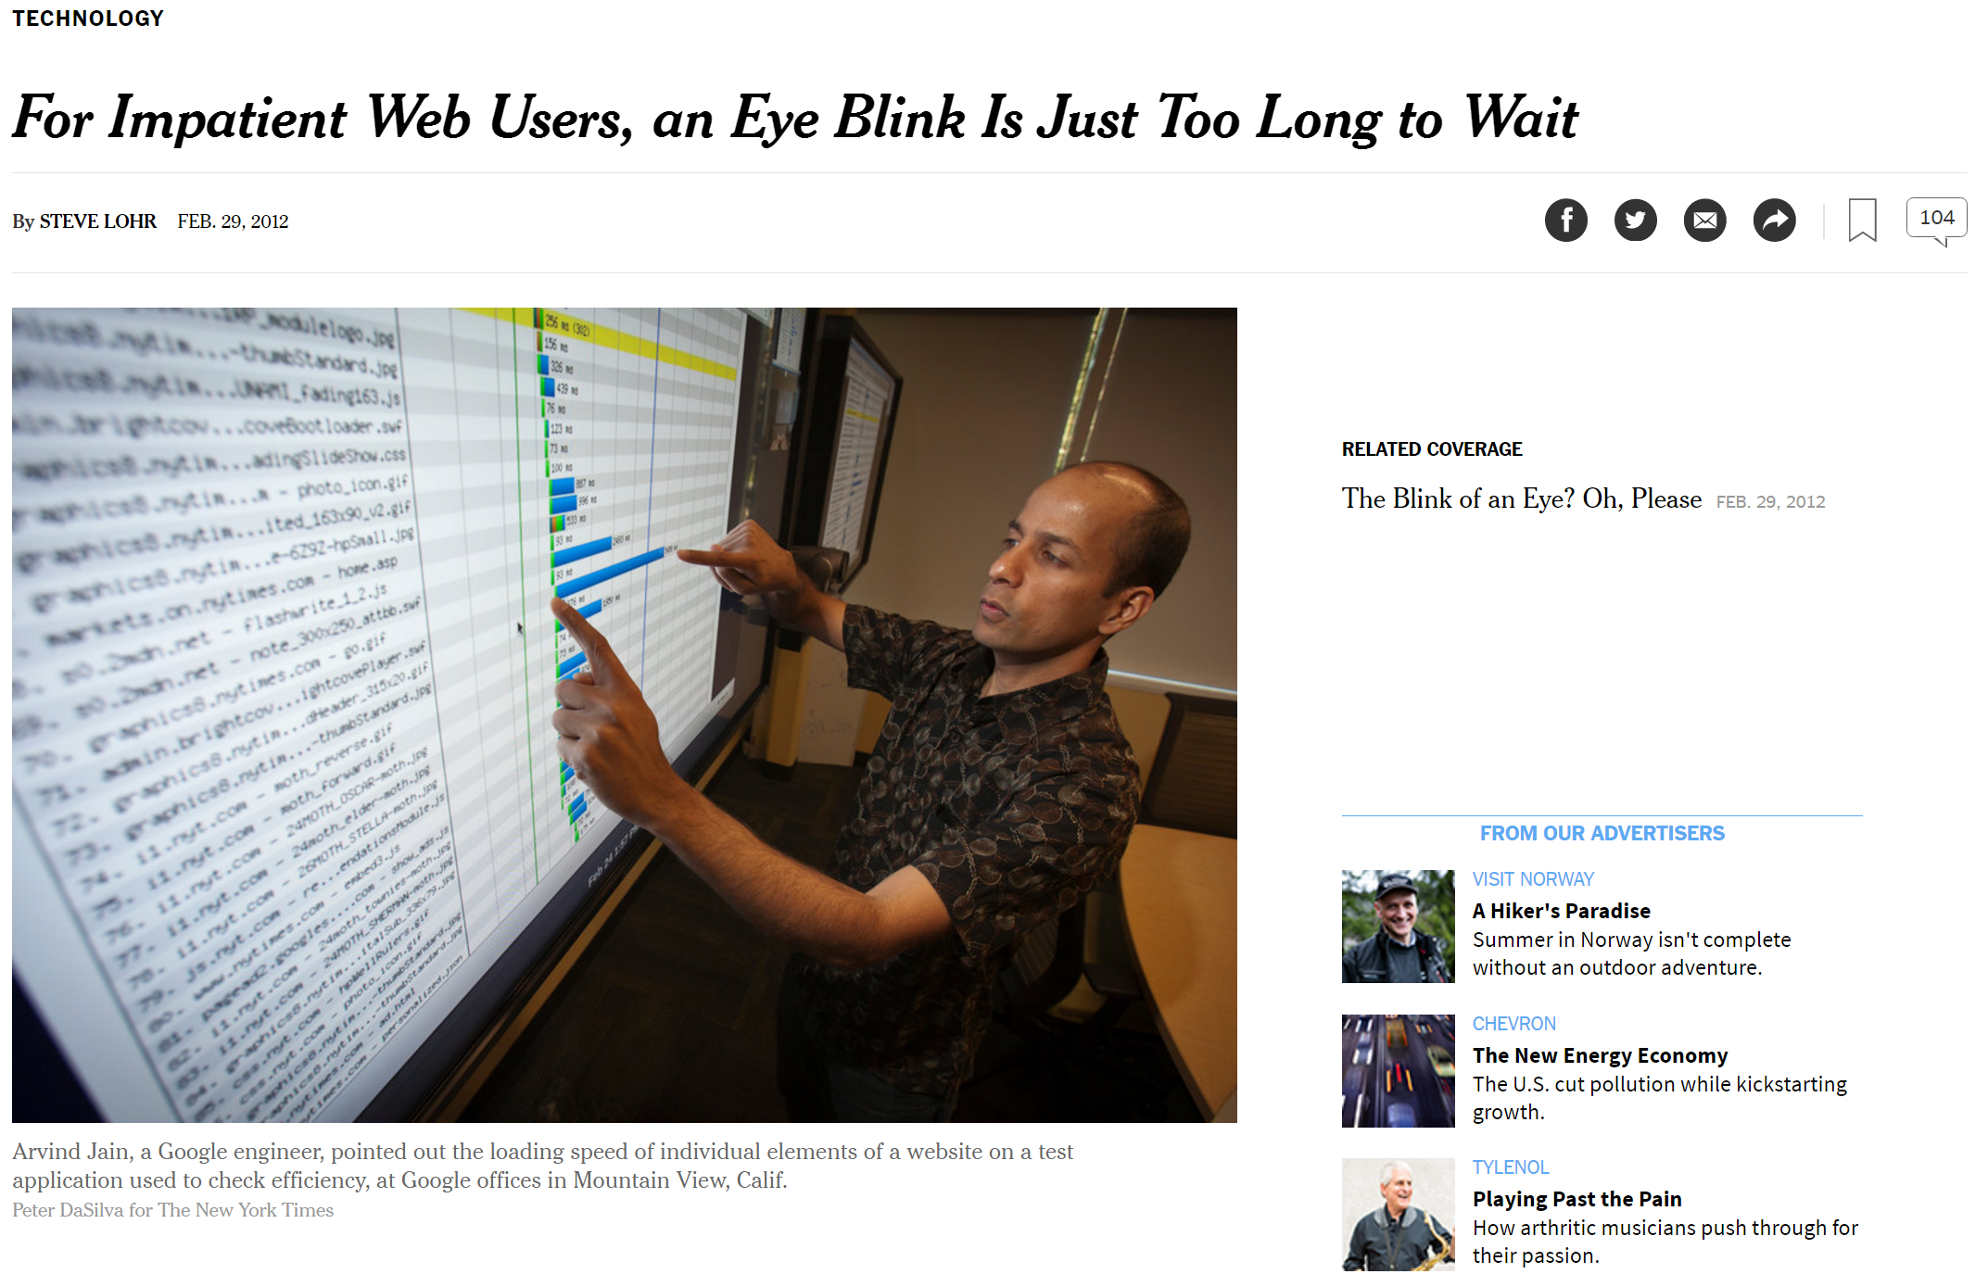
How Does This Apply to Web?
http://www.nytimes.com/2012/03/01/technology/impatient-web-users-flee-slow-loading-sites.html
Notes:
http://www.nytimes.com/2012/03/01/technology/impatient-web-users-flee-slow-loading-sites.html

Slide 40
How Does This Apply to Web?
People will visit a Web site less often if it is slower than a close competitor by more than 250 msec
“Two hundred fifty msec, either slower or faster, is close to the magic number now for competitive advantage on the Web,” said Harry Shum, a computer scientist and speed specialist at Microsoft.
On a mobile phone, a Web page takes a leisurely nine seconds to load, according to Google, which tracks a huge range of sites from the homes of large companies to the legions of one-person bloggers. Download times on personal computers average about six seconds worldwide, and about 3.5 seconds on average in the United States.

Slide 41
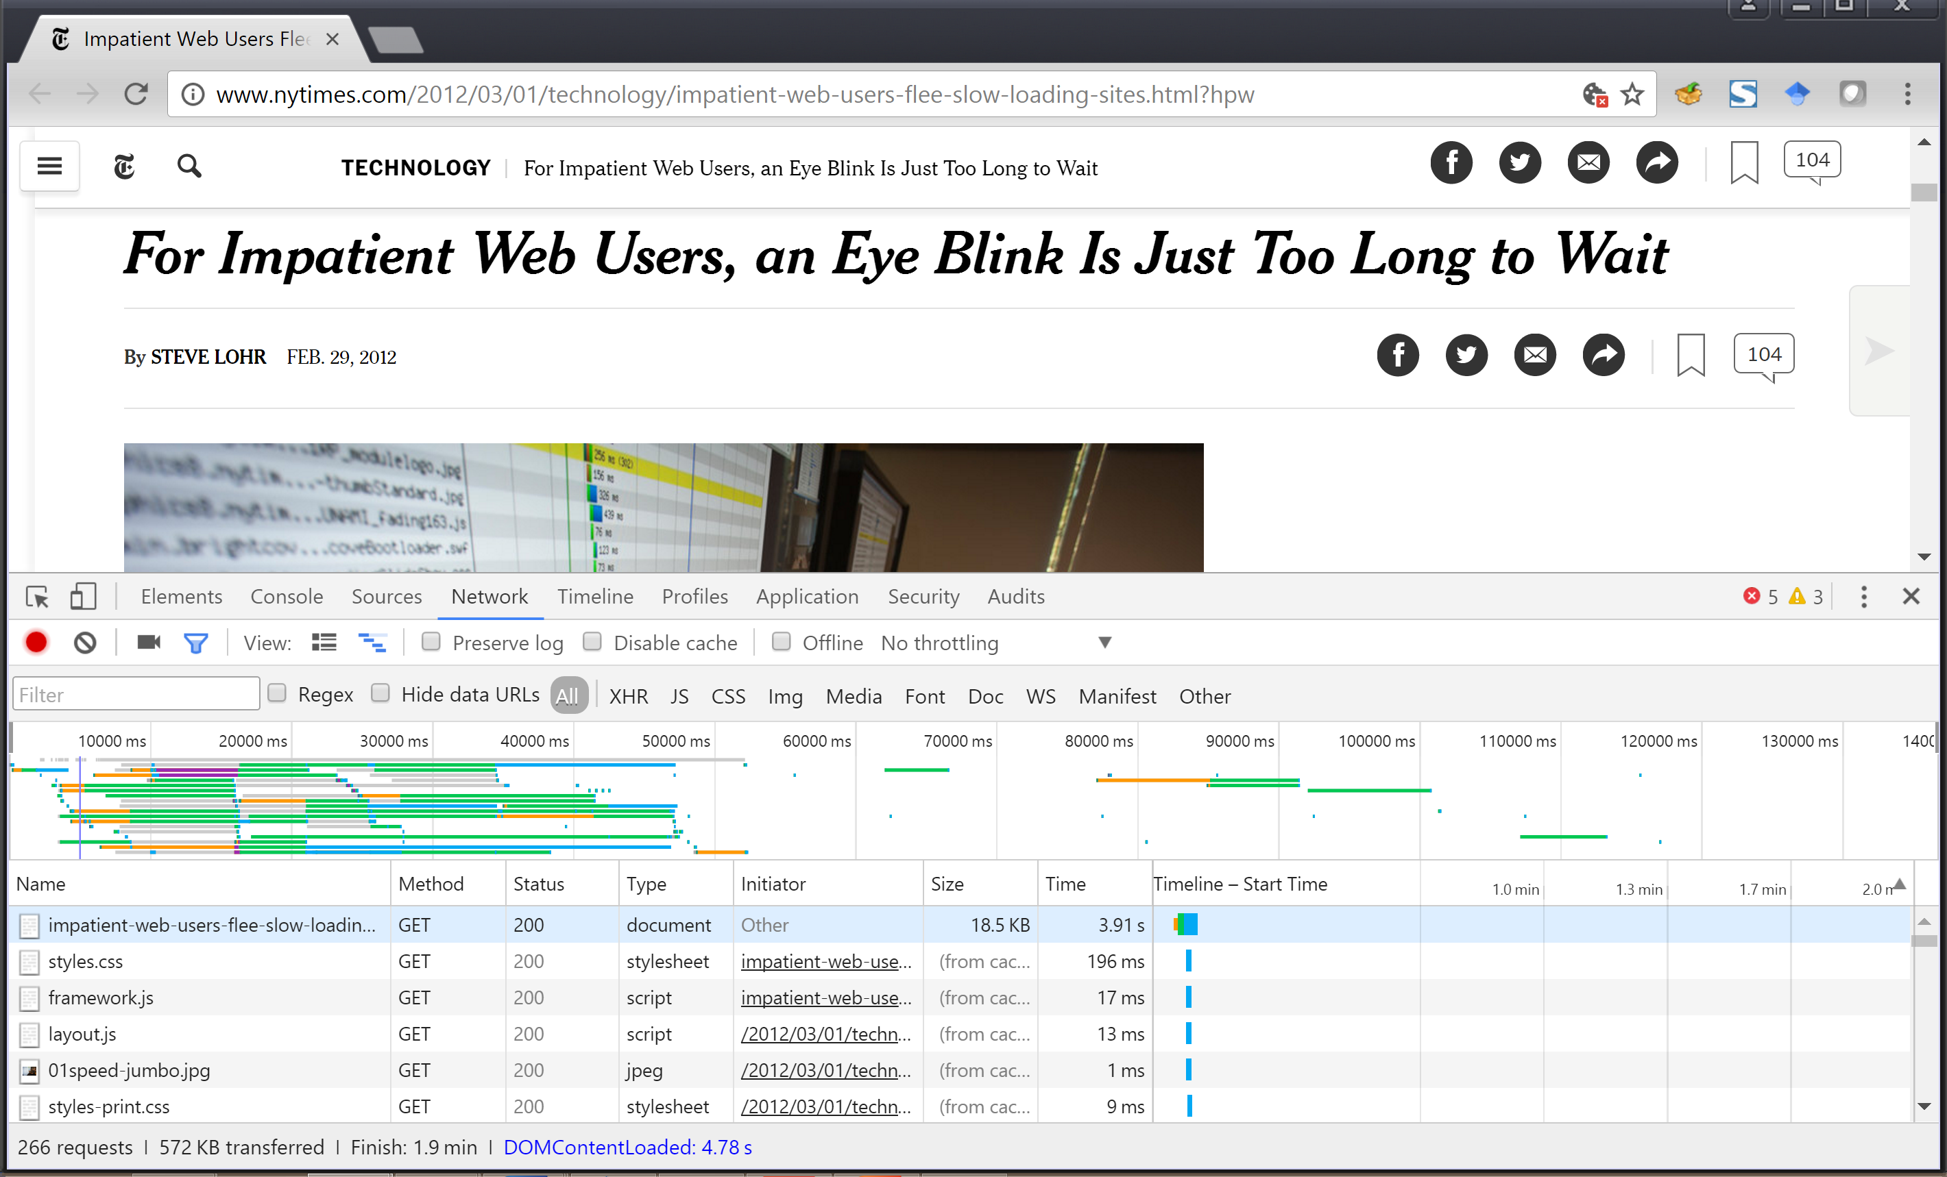
Aside: Analyzing Web Load Time
Notes:
Can use Chrome tools to see load times, can help you optimize

Slide 42

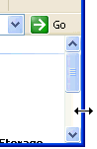


Feedforward
What will happen if you execute action
Ex. Web page mouseover
Ex. Word processing I-bar
Ex. Label on a button
Help people predict what will happen
Need feedforward at all scales
GUI widgets will handle basic feedforward
Don’t forget feedforward for screens too
Remember the “Start Recording” example?

Slide 43
Performance Properties of People
Feedback depends on properties of people
How much can people remember?
How fast are things perceived?

Slide 44
How Much Can a Person Remember?
Short term (working) memory
Small capacity (7 ± 2 “chunks”)
2461827176 vs (412) 268-1776
YBEAMBIMGC vs EBAY IBM GMC
Rapid access & decay
Note: recent work suggests lower number
Long-term memory
Huge, but slower access time
Requires effort and may not always work on cue

Slide 45
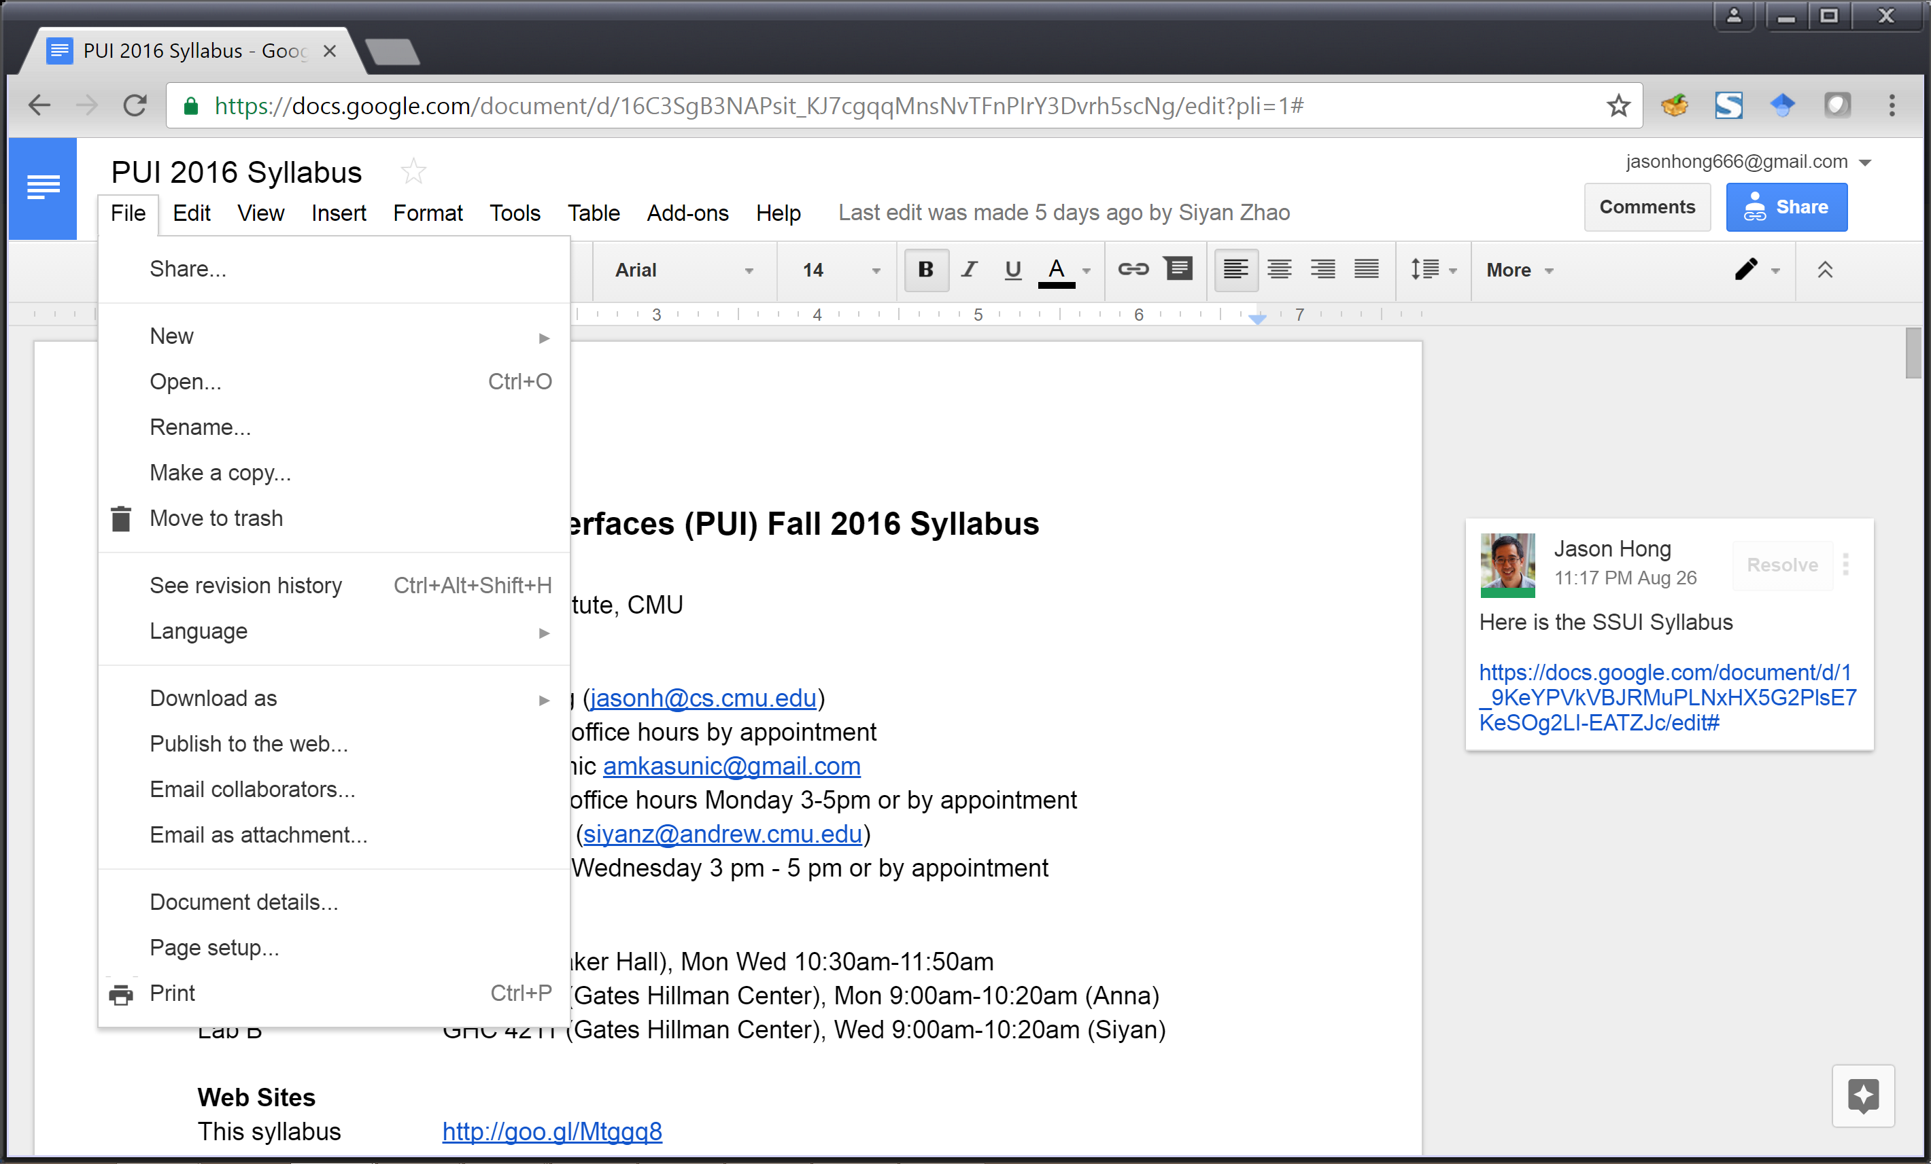
Note how menus are chunked
Similar items clustered
Also note number of items in each chunk
(Also note the use of keyboard shortcuts and the ellipses …)
Notes:
Menus are designed around the 7 +- 2

Slide 46
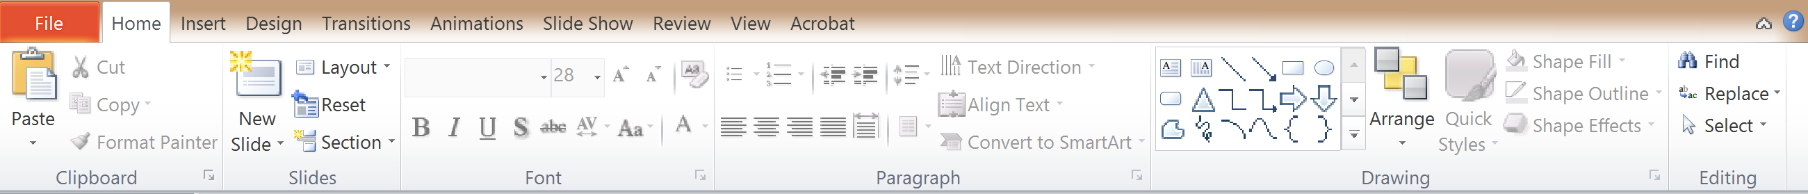
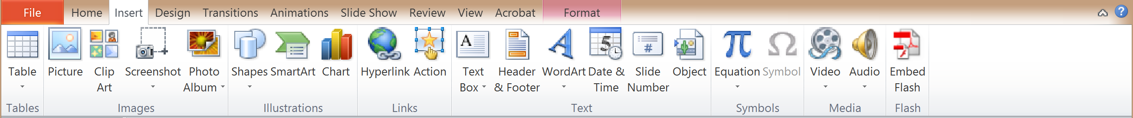
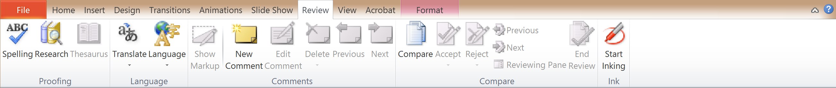
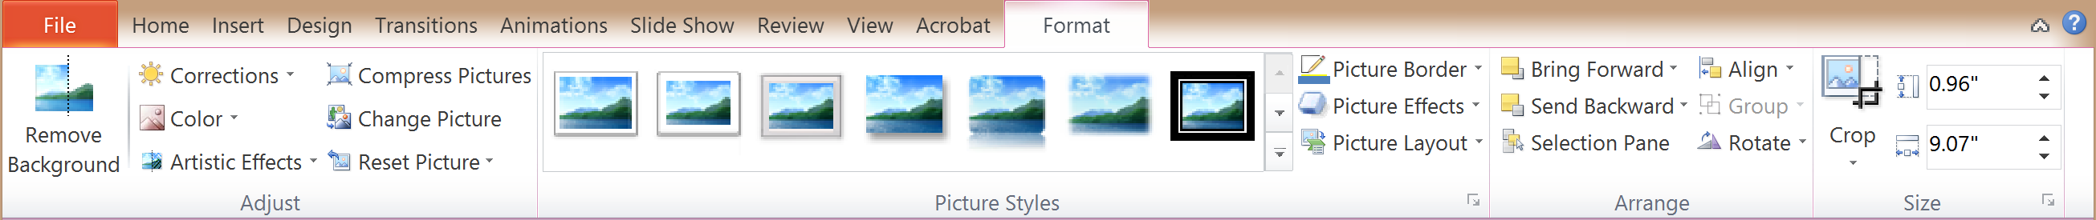
Notice Chunking of the Ribbon UI
Notes:
Note that chunking and 7 +- 2 here in Powerpoint’s ribbon menu
About 7 top level items
About 7 subitems under each

Slide 47
Simple Experiment
Need a victim volunteer
Start saying the color you see in list of words
When slide comes up
As fast as you can
Say “done” when finished
Everyone else time it…
Will do this twice
Alice
You say “Black”
Bob
You say “Blue”

Slide 48
Page
Paper
Back
Schedule
Change
Home

Slide 49
Blue
Red
Black
White
Green
Yellow

Slide 50
Implications for Design
This interference of color word is known as the Stroop effect
(You don’t need to know this term for exams)
Be careful of interference effects when there are two or more strong cues in working memory
This interference can lead to a kind of slip
Link to different chunks in long term memory
Given all of this, what’s interesting about these vending machines?

Slide 51
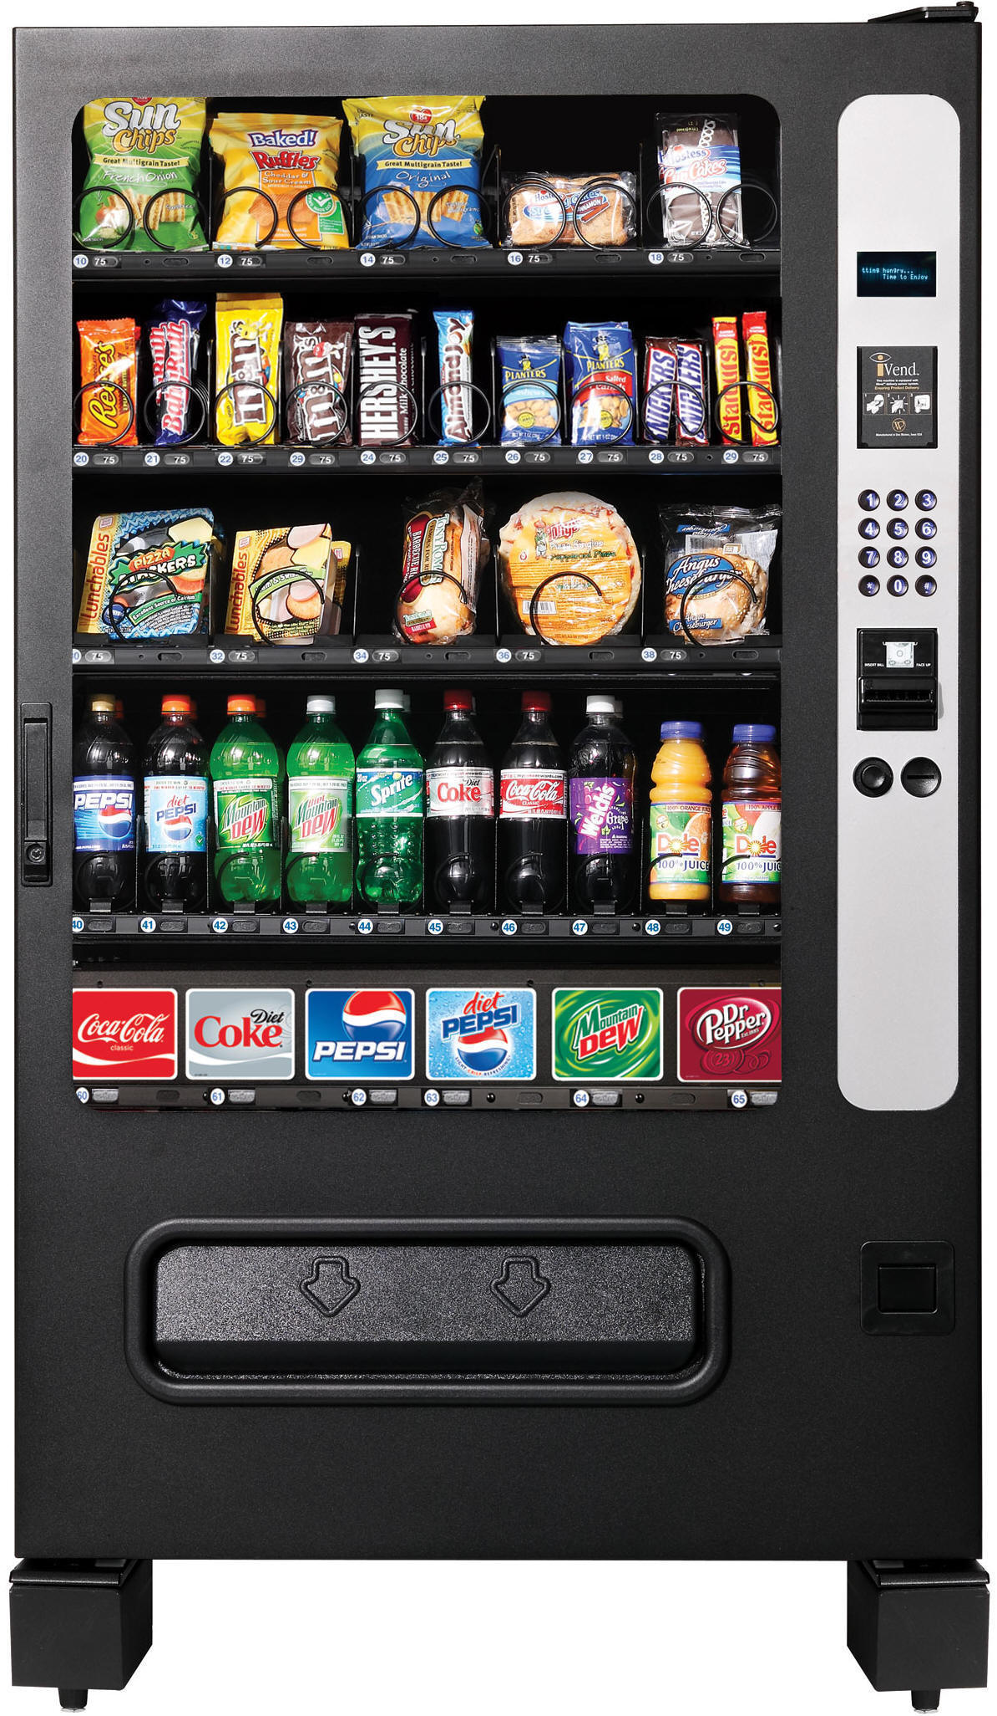
Notes:
Potential interference, might enter in the price instead of the item# you want.
How might you fix this?

Slide 52
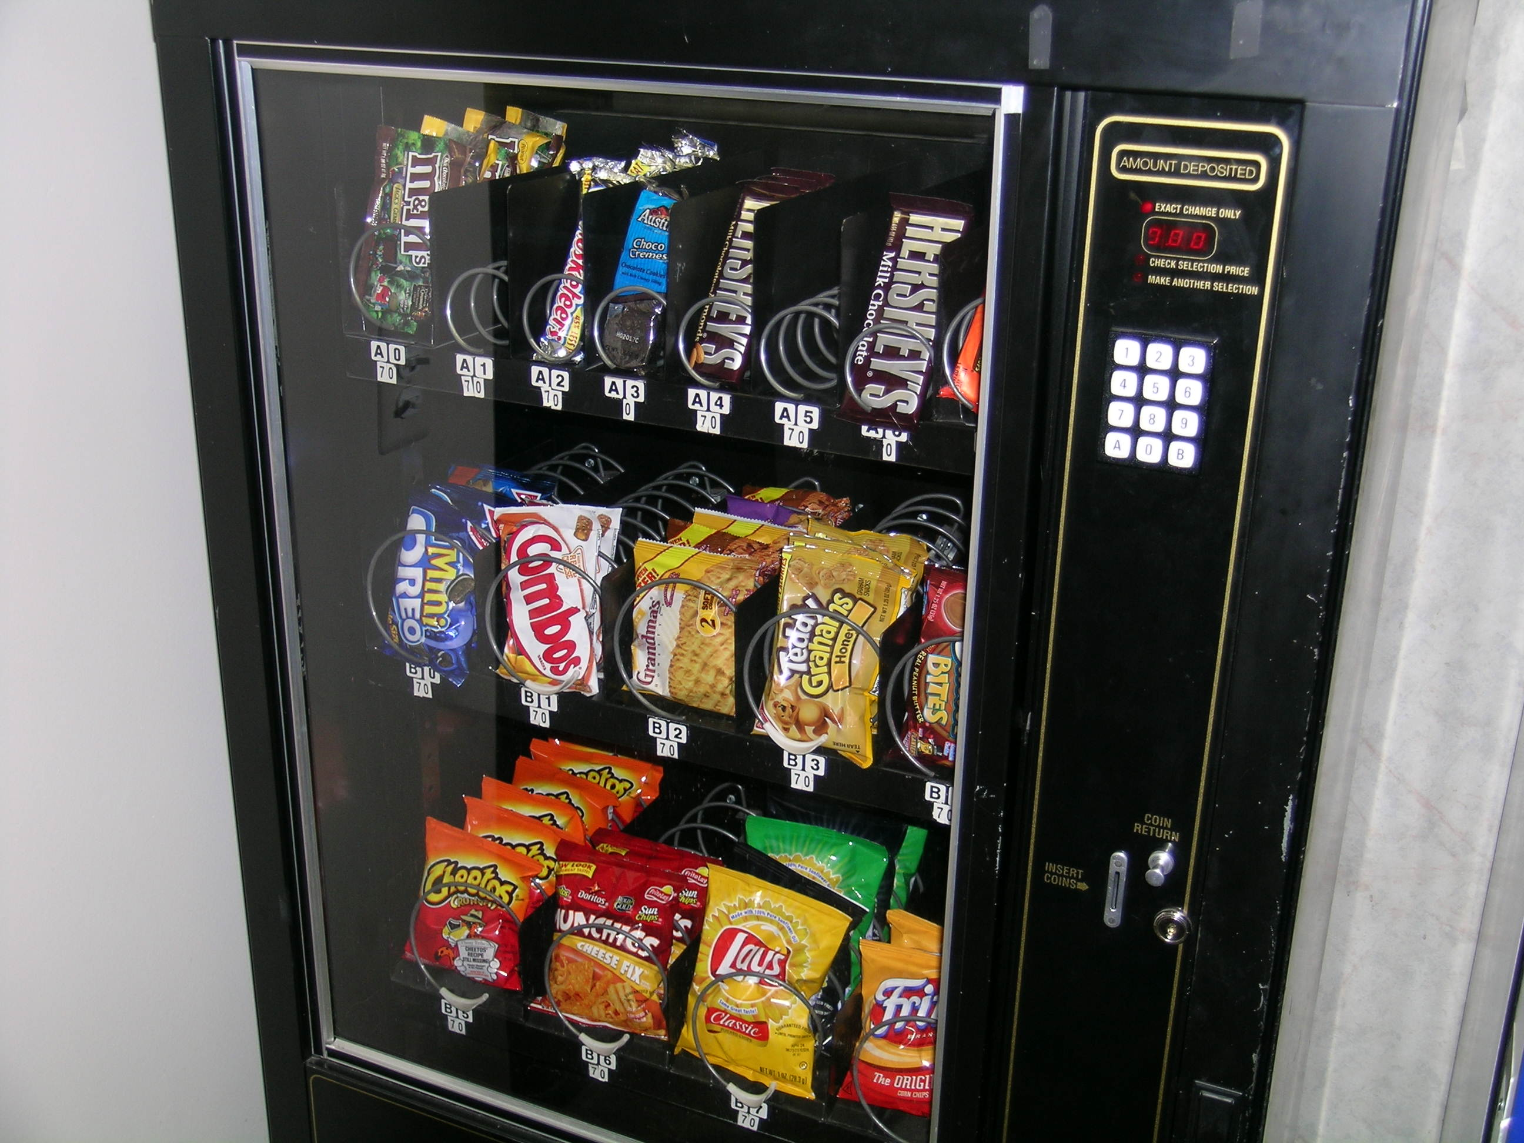
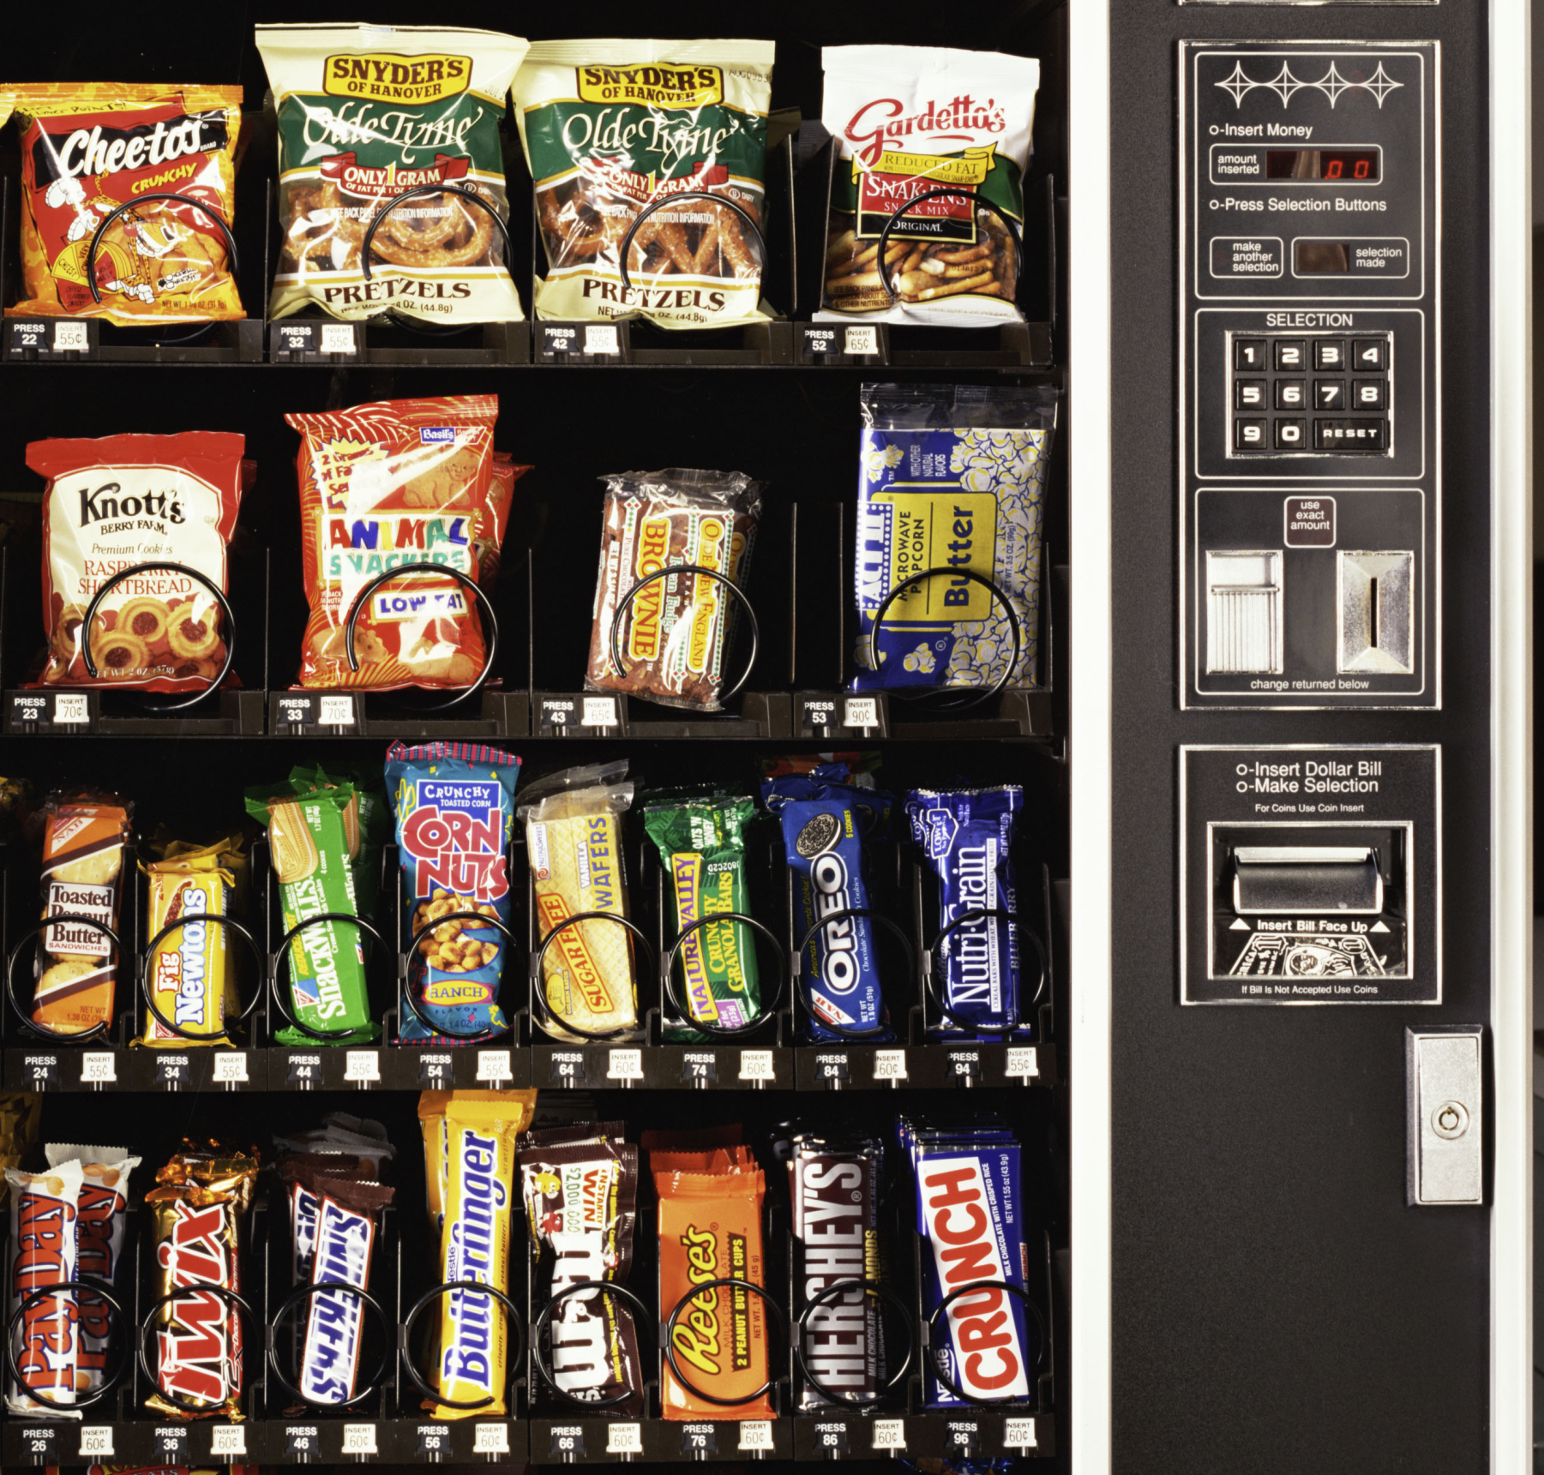
Notes:
Picture from Wikipedia
Good example of avoiding interference, note that you have to hit A or B first

Slide 53
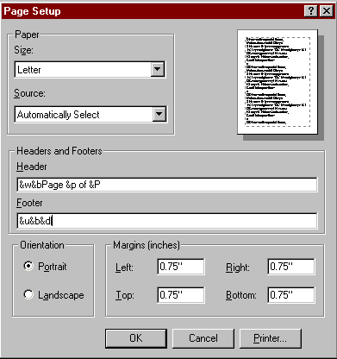
Design Strategy Recognition over Recall
One way to minimize interference and deal with limited memory
Recall
Reproduced from memory
Recognition
Ex. command in menu reminds you of semantics
Retrieval cues, e.g., icons, labels, menu names, etc.

Slide 54
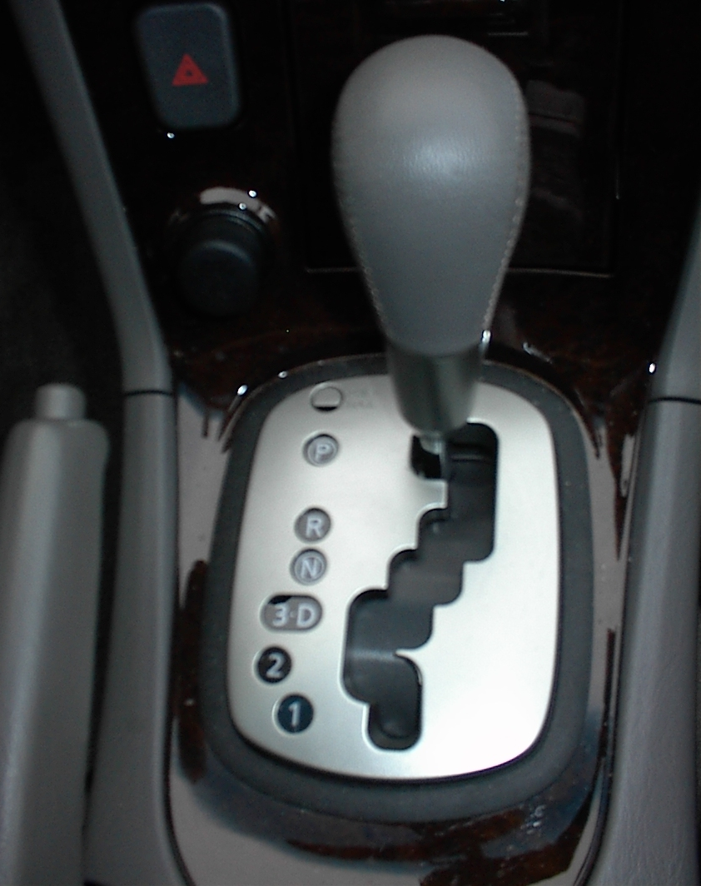
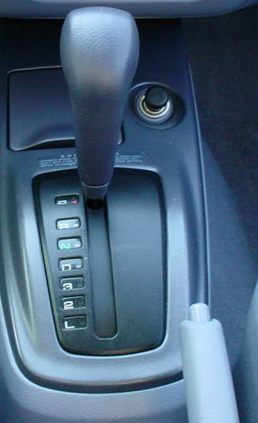
What Might Go Wrong Here?
Notes:
This is an actual design from Nissan Maxima
I took this picture of my brother’s car. Turns out he was driving his car wrong for over a year before I pointed out something to him
Turns out he was driving in 3rd gear instead of D. Easy mistake to make.
Note that it’s almost impossible to make this mistake on the right (older Nissan Maxima gear shift)

Slide 55
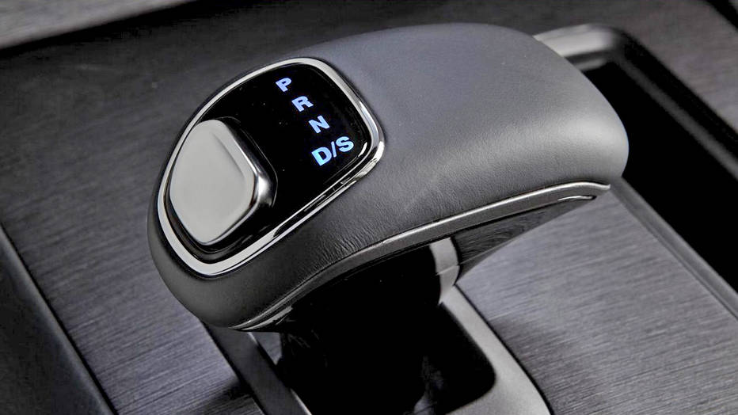
Mode Error + Lack of Mapping
Notes:
We saw this earlier in the semester with mode errors
Sadly, this design for Jeep led to Anton Yelchin’s death
Mode error
This design lacks visibility, it’s a relative shift vs an absolute one like the one on the next screen

Slide 56
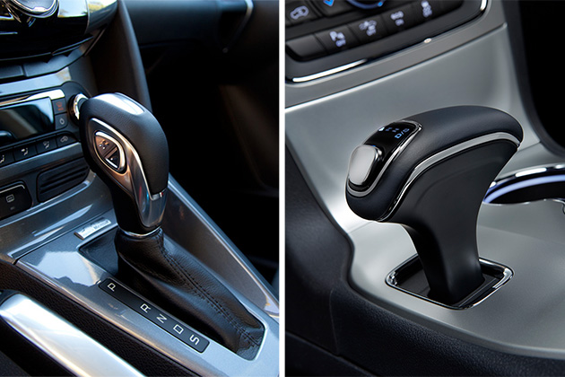
Mode Error + Lack of Mapping
Mode errors
Notes:
Sadly, this design for Jeep led to Anton Yelchin’s death
Mode error + mapping error
Note that left one (older design) it’s harder to make this kind of mode + mapping error

Slide 57
Map Interface Controls
Controls should mirror real-world
Which is better for dashboard speaker front / back control?
Dashboard

Slide 58
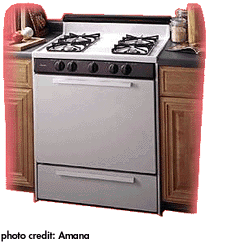
What is the Potential Problem, and How Might You Fix?

Slide 59
Map Interface Controls

Slide 60
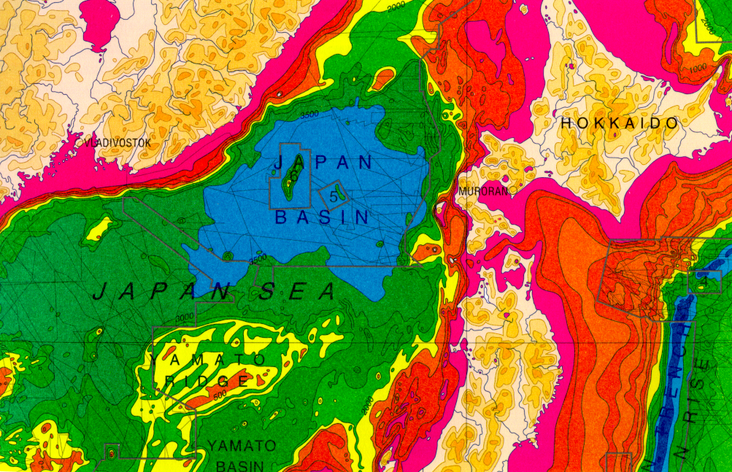
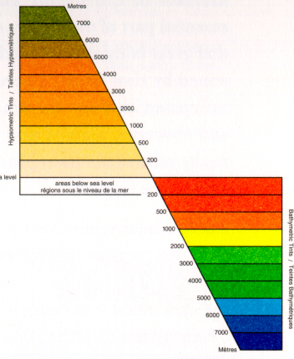
Map #1: Poor Mapping of Colors
Notes:
While it is certainly true that hues have a physical order via their wavelength, and that every kindergardener knows the rainbow ordering, our visual system has a very difficult time treating hue in an ordered way. As we see in this image, it is clear that each area is *different*, but none of the areas have an intuitive relationship between each other. Where is above ground? Where is below? What’s the highest point? These questions are hard to answer. (Saturation as a cue is nearly impossible to handle.)

Slide 61
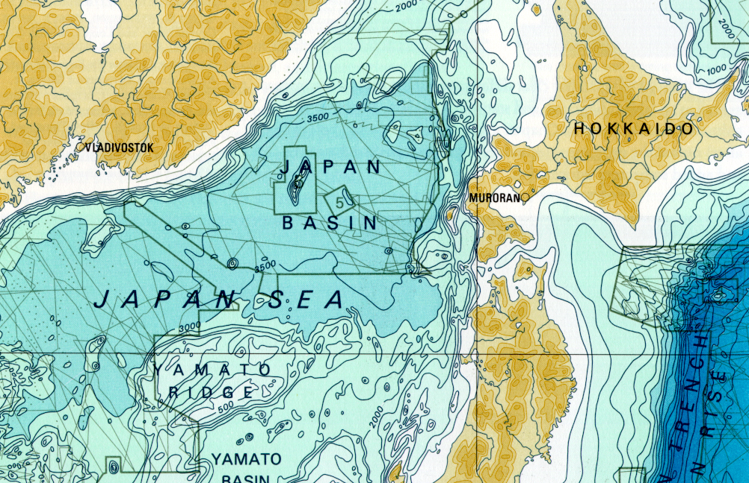
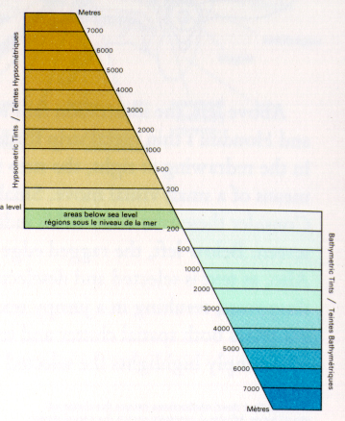
Map #2: Better Mapping of Colors
Notes:
Color sets that vary primarily by luminance are much easier for us to order. This image uses two color sets: browns for above ground, blues for below. The questions I mentioned before are now much easier to answer. The much more muted colors also much easier to read the information.

Slide 62
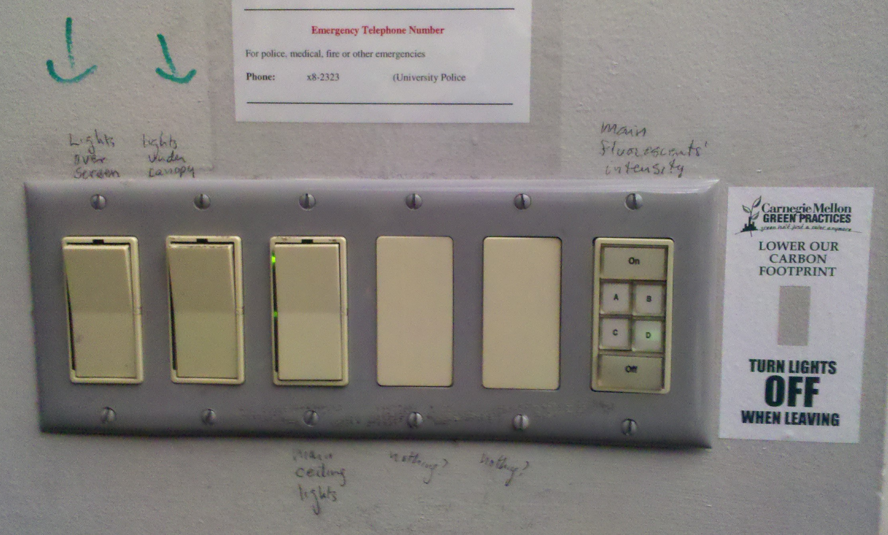
Newell Simon Hall 1305 (old)
Notes:
This was so confusing that someone wrote on the wall

Slide 63
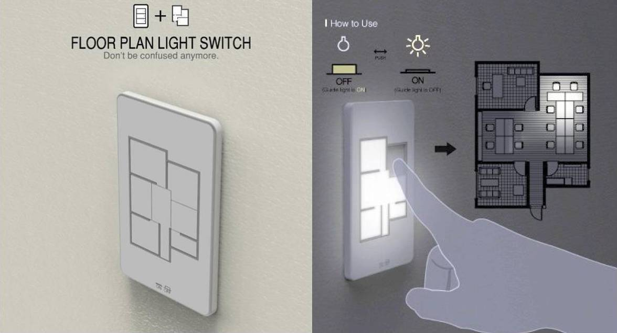

Slide 64
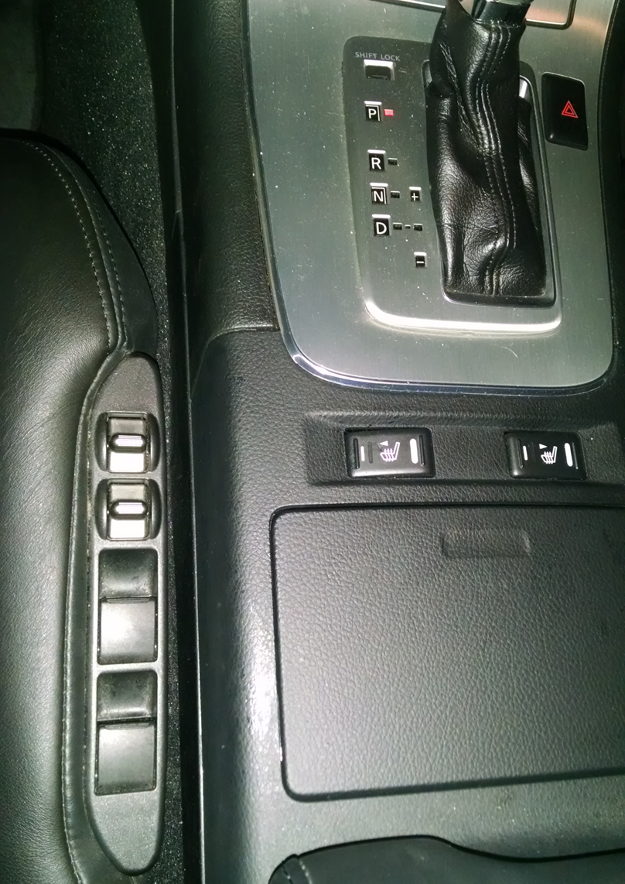


Notes:
Left side is my car seat controls, no mapping, I always get it wrong.
Compare to these other cars, much easier to get right.

Slide 65
How to Address Gulf of Evaluation and Execution?
Mental Models
Affordances
Feedback
Mappings
Visual Grouping / Separation
Metaphor

Slide 66

What’s Wrong Here?

Slide 67
Visual Grouping Ideas on How to Fix this Problem?
5
6
3
4
1
2

Slide 68
Visual Grouping
5
6
3
4
1
2

Slide 69

Visual Grouping
Notes:
Another way to fix the problem

Slide 70

Visual Grouping
Notes:
Another way to fix

Slide 71

Visual Grouping
Notes:
Stick the number on the button itself

Slide 72

Amazon Had Grouping Problems

Slide 73

Poor (and misleading) grouping

Slide 74

Also poor and misleading grouping

Slide 75

Some Visual Grouping Strategies
Proximity
Similarity
Connected

Slide 76
Revisiting this Design
Mental models problem
Also mapping problem
Also visual grouping problem
(These problems not mutually exclusive)
You now have better vocabulary for talking about problems

Slide 77
Making Things Distinct
Grouping looks at how to make things look related
What if we want to make things look different and stand out?

Slide 78

Making Things Distinct
Size
Value
Orientation
Texture
Shape
Position (2D / 3D)
From Kevin Mullet and Darrell Sano, Designing Visual Interfaces
Notes:
Note that while size and other cues provide for quantitative comparison, color (even luminance) only provides for ordering.
If the goal is contrast along any of these axes, make it distinct!

Slide 79
Let’s Play a Game
I’ll show you a series of pictures
Say out loud:
Same if every object is the same
Different if at least one object is different
Same
Different

Slide 80

Notes:
http://www.webdesignfromscratch.com/grouping.cfm
http://www.csc.ncsu.edu/faculty/healey/PP/

Slide 81

Notes:
http://www.webdesignfromscratch.com/grouping.cfm
http://www.csc.ncsu.edu/faculty/healey/PP/

Slide 82


Slide 83


Slide 84


Slide 85
Is there a red circle on the next image?
Say “yes” or “no”

Slide 86

Notes:
Why is this one harder?

Slide 87
Preattentive Processing
Some things easy for low-level visual processing to automatically handle
It just pops out at you
Preattentive processing
~200 msec to see diffs
Based on simple diffs
Doesn’t work for multiple diffs
Is there a red circle? →
No popout effect here

Slide 88



Making Things Distinct
Shape
Color
Size
Notes:
http://www.webdesignfromscratch.com/grouping.cfm
http://www.csc.ncsu.edu/faculty/healey/PP/

Slide 89

Notes:
Here is the gmail interface once again.
Note how the two main buttons popout, mostly because of good contrast relative to rest of screen

Slide 90

Small Multiples for Making Things Distinct
“Information consists of differences that make a difference.”
– Edward Tufte, Envisioning Information
IMAGE REMOVED

Slide 91


International Women’s Day
Echeverria, Heriberto 1971 March 8 - International Women’s Day
Diaz, Estela 1974 March 8 - International Women’s Day
Cuban Poster Art Gallery, http:///www.sims.berkeley.edu/~lcush/GenCat.html/

Slide 92

Reid Miles, Blue Note Cover

Slide 93






Small Multiples Poor Examples
Notes:
Here are bad examples of multiples (and also mapping)
No clear mapping

Slide 94

Small Multiples
Not having clear differences makes it hard to understand
Versus…

Slide 95
Aside: Change Blindness
People poor at noticing some kinds of changes
Subtle changes over time
Distractors
Discontinuities (Ex. in movies)
Videos
https://www.youtube.com/watch?v=ubNF9QNEQLA
http://www.gocognitive.net/sites/default/files/change_blindness.v.0.93_0.swf
Basketball study
https://www.youtube.com/watch?v=0grANlx7y2E
Door study
https://www.youtube.com/watch?v=FWSxSQsspiQ
Notes:
Gorilla video http://viscog.beckman.uiuc.edu/grafs/demos/15.html

Slide 96

Web Pages and Change Blindness

Slide 97
Subtle Change
Please fill in the required fields
Notes:
Note that the error is so subtle, very easy to miss (mocked up example)

Slide 98

Have Major and Obvious Changes

Slide 99
Summary for Today
More vocabulary for describing problems and solutions
Note how many examples have multiple problems
Mental models, Affordances, Mappings, Visual Grouping
What they are, why important, some examples
Mental models: designer, user, system image
Feedback / Feedforward
Different time scales, perceived time

Slide 100
Summary for Today
Short-term memory
Roughly how much, interference effects
Pre-attentive processing, Change blindness
We’ll continue with metaphors and interaction techniques next time

Slide 102

Metaphor
Definition
“The transference of the relation between one set of objects to another set for the purpose of brief explanation.”

Slide 103

Metaphor
Lakoff & Johnson, Metaphors We Live By
“...the way we think, what we experience, and what we do every day is very much a matter of metaphor.”
in our language & thinking “argument is war”
He attacked every weak point
Criticisms right on target
If you use that strategy
relationships and navigation
Going in the wrong direction
Took a u-turn
We’re splitting apart

Slide 104

Desktop Metaphor
Can use metaphors to leverage existing conceptual models
Not really an attempt to simulate a real desktop
Leverages existing knowledge about files, folders, trash
A way to explain why some windows seem blocked

Slide 105


Example Metaphors
Data and Function
To-do list, calendars
Collections
Drawers, files, books, newspapers, photo albums, shopping cart, wish list
Actions
Cut, copy, paste
Notes:
Develop interface metaphor or conceptual model
Communicate that metaphor to the user
Provide high-level task-oriented operations not low-level implementation commands

Slide 106


ThinqOn
Notes:
Notebook metaphor (works ok in this case)
Strange house metaphor for organizing discussion boards

Slide 107




Metaphors Not Always Effective
Older Mac OS desktop inconsistent
Dragging disk to trash
Should delete it, not eject it
Notes:
Here’s another example we saw before

Slide 108

Metaphors Not Always Effective
General Magic’s Magic Cap for PDAs
Unwieldy, not great use of screen real estate

Slide 109



Slide 110


Metaphors Not Always Effective
Microsoft Bob
Set expectations too high

Slide 111



Designs Can Also Be Too Literal
Notes:
Skeuomorphic interfaces
Beyond Being There
Can be a start, but don’t want to be artifically constrained by physical limitations too

Slide 112


Notes:
Skeuomorphic UIs

Slide 113

Story Time
Tony Fadell in charge of platform
One of creators of iPod
Founded Nest Labs
Young engineer that worked on Magic Cap, later co-founded Danger Inc
Made the Danger Sidekick
Bought out by Microsoft

Slide 114

Story Time
Later on, formed a company called Android
Andy Rubin
Bought out by Google
Why tell you this?
Sometimes you won’t get it right your first try
Or your second try
Or even third try
But if you have a strong vision and are willing to take a risk, you just might succeed

Slide 115
Summary
Mental models, Affordances, Mappings, Visual Grouping, Metaphors
What they are, why important, some examples
Three parts to mental models: designer, user, system image
Feedback / Feedforward
Different time scales, perceived time
Short-term memory
Roughly how much, interference effects
Pre-attentive processing, Change blindness

Slide 116
How many 3’s?
1281768756138976546984506985604982628584582245098564589450984509809435909103020990595959579809858458224509856458945098450980943585725646750506789045678845789809821677654876364908560912949686

Slide 117
How many 3’s?
1281768756138976546984506985604982628584582245098564589450984509809435909103020990595959579809858458224509856458945098450980943585725646750506789045678845789809821677654876364908560912949686

Slide 118

Short Break
https://www.youtube.com/watch?v=LkqiDu1BQXY
Notes:
https://www.youtube.com/watch?v=LkqiDu1BQXY
Be sure to explain the setup a lot
People from the future, they have advanced user interfaces, speech-based interfaces
This person has never seen a mouse before

Slide 119

How did Apple “teach” people how to use iPhone?

